Slide 1
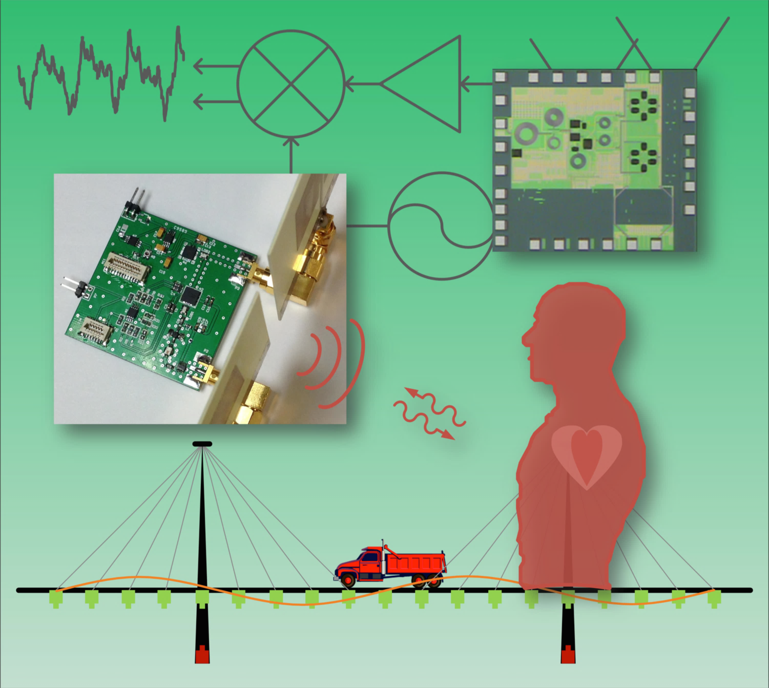
Biomedical Radar for Future Pervasive Healthcare Monitoring
Prof. Jenshan Lin
University of Florida
Gainesville, Florida, USA

Slide 2
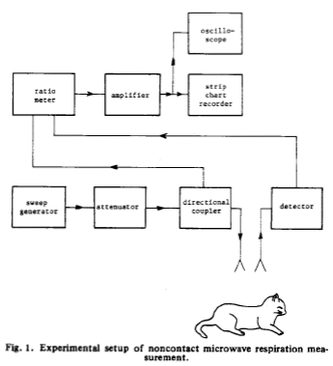
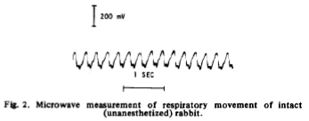
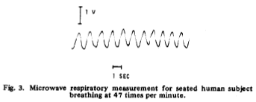
Earliest Research Report
Detect amplitude variation
Rabbit
Respiratory movement
Human
10 GHz CW
10 mW
30 cm
J. C. Lin, J. Salinger, "Microwave measurement of respiration,” IEEE MTT-S Int. Microwave Symp. Dig., pp. 285-287, 12- 14 May 1975.
J. C. Lin, "Noninvasive Microwave Measurement of Respiration," Proceedings of the IEEE, vol. 63, no. 10, p. 1530, Oct. 1975.

Slide 3
First Non-Contact Vital Sign Sensor Chip
0.25 µm BiCMOS
3.75 mm x 3.75 mm
1.6 GHz transmitted
Direct-conversion RX
Free-running VCO
TX power = 6.5 dBm
Free-running VCO. No PLL.
A. D. Droitcour, O. Boric-Lubecke, V. Lubecke, J. Lin, “0.25μm CMOS and BiCMOS Single Chip Direct Conversion Doppler Radars for Remote Sensing of Vital Signs,” IEEE International Solid State Circuits Conference Digest of Technical Papers, pp. 348-349, 2002.

Slide 4
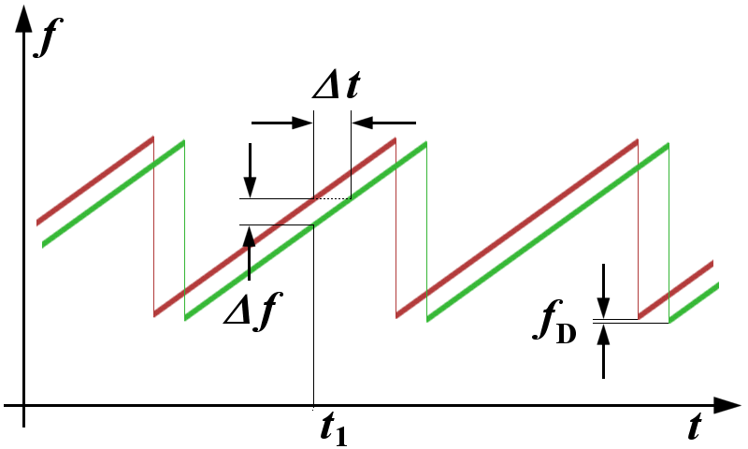
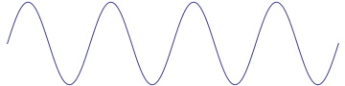
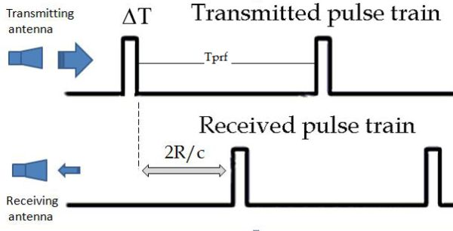
Different Types of Vital Sign Radar
Frequency-Modulated Continuous-Wave (FMCW)
Continuous-Wave (CW) – unmodulated
Pulsed Radar (e.g., UWB Radar)
Possible to use more complex waveforms

Slide 5
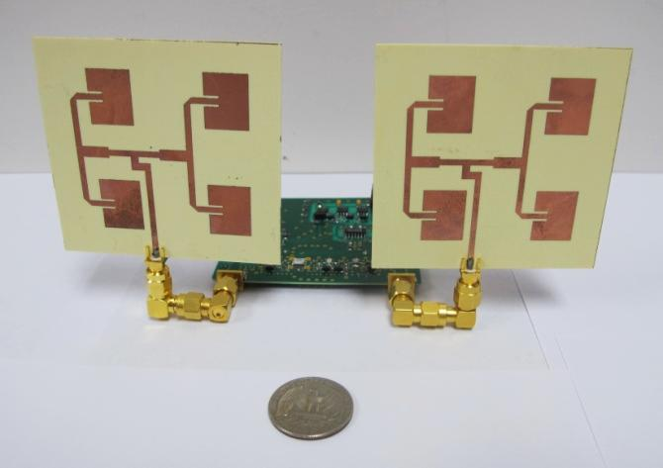
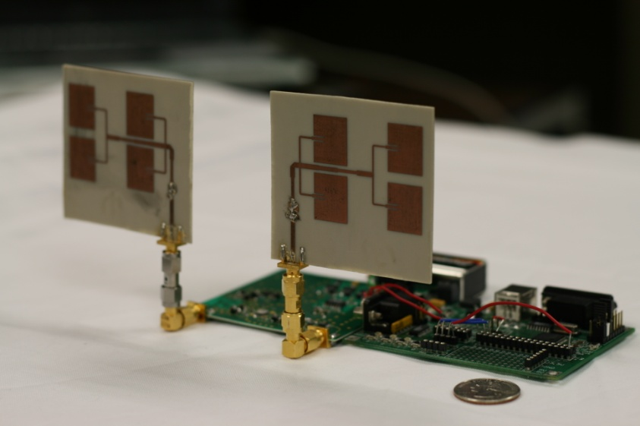
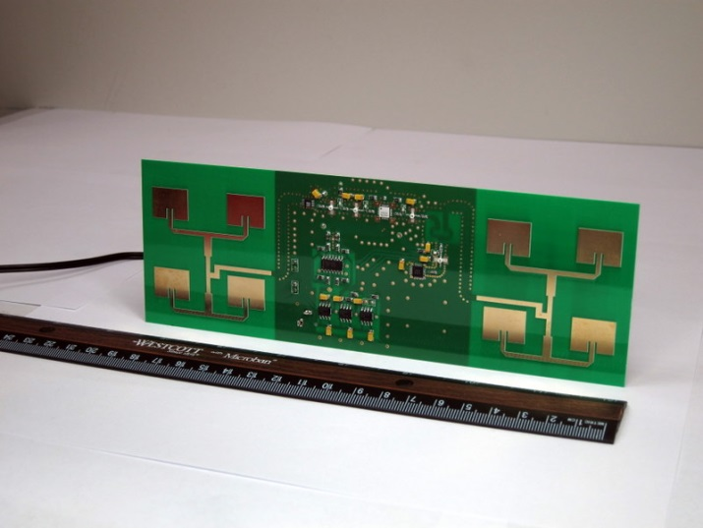
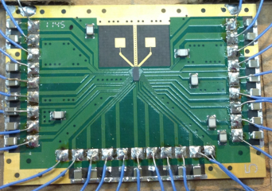
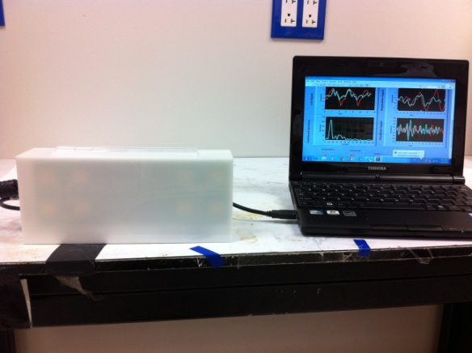
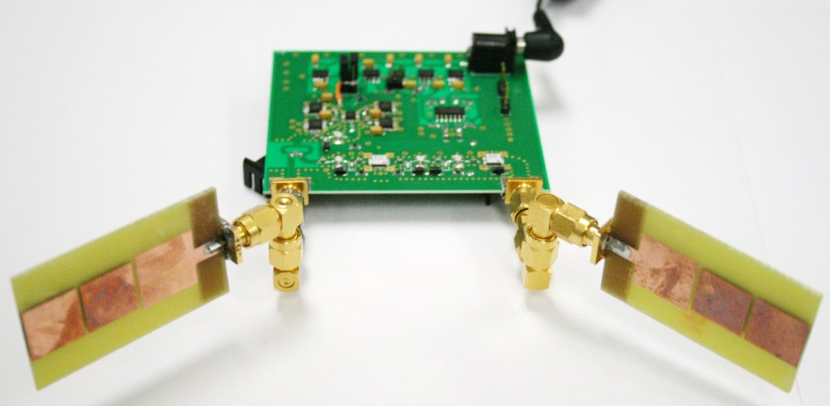
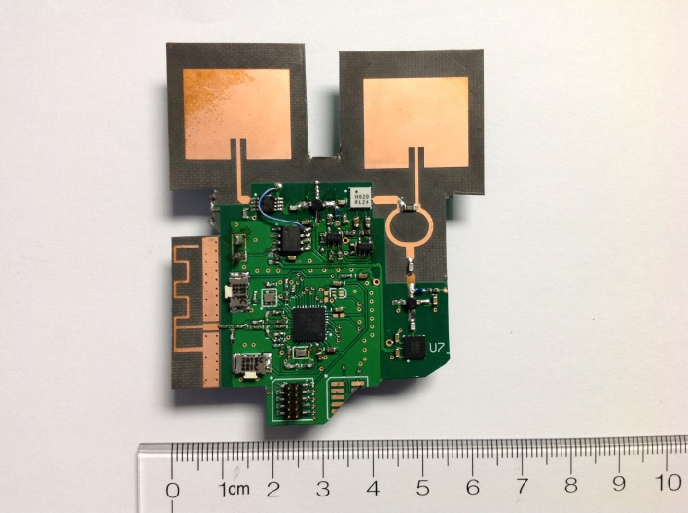
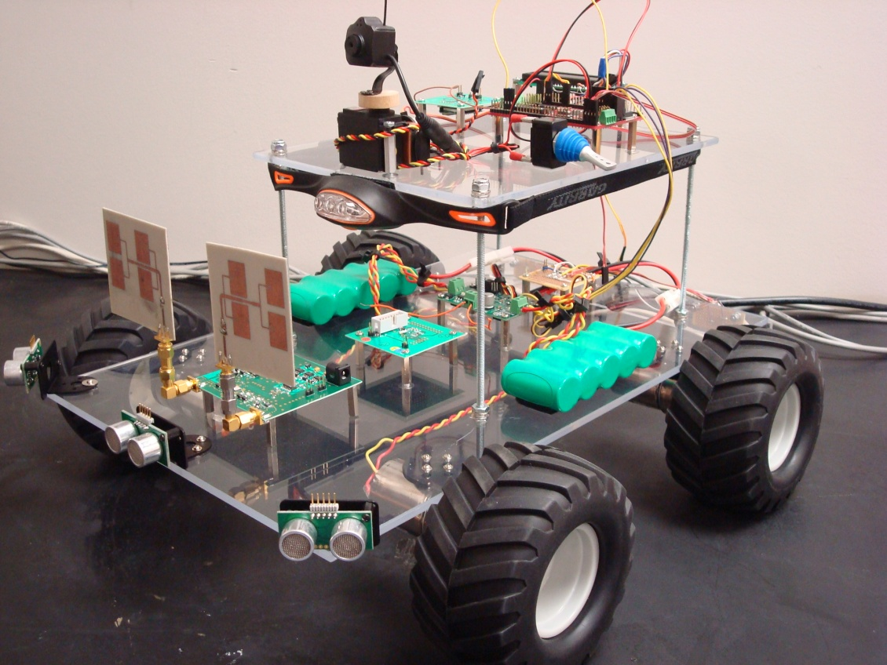
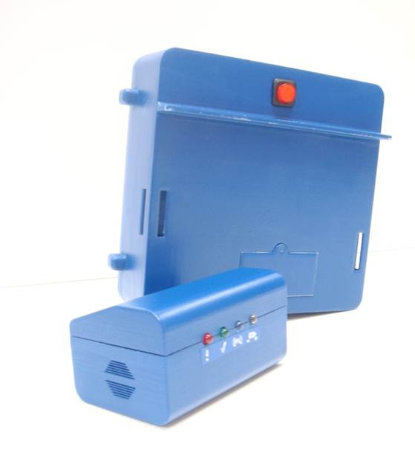
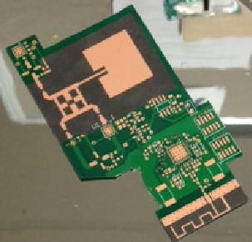
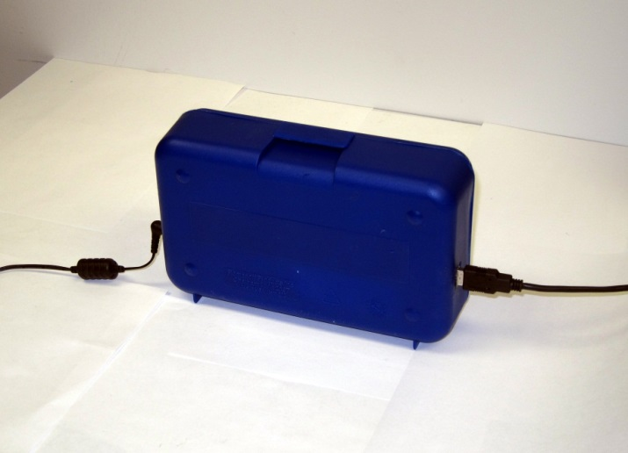
Portable Vital Sign Radars @ UF

Slide 6
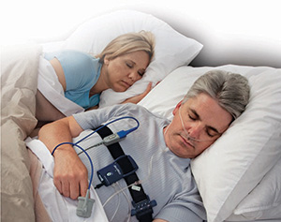
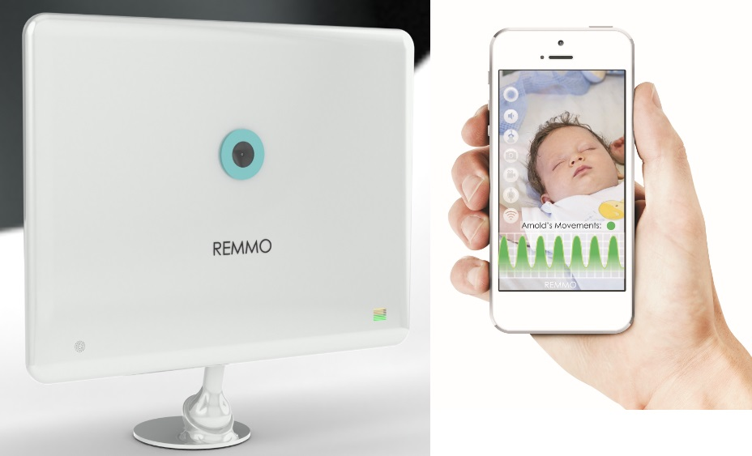
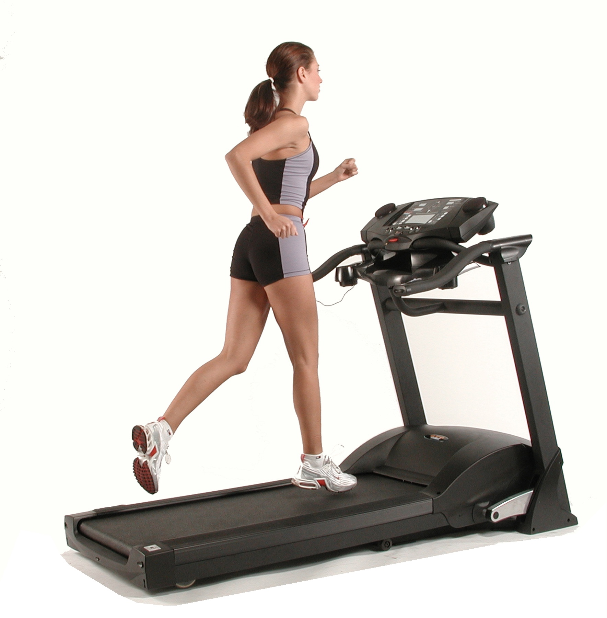

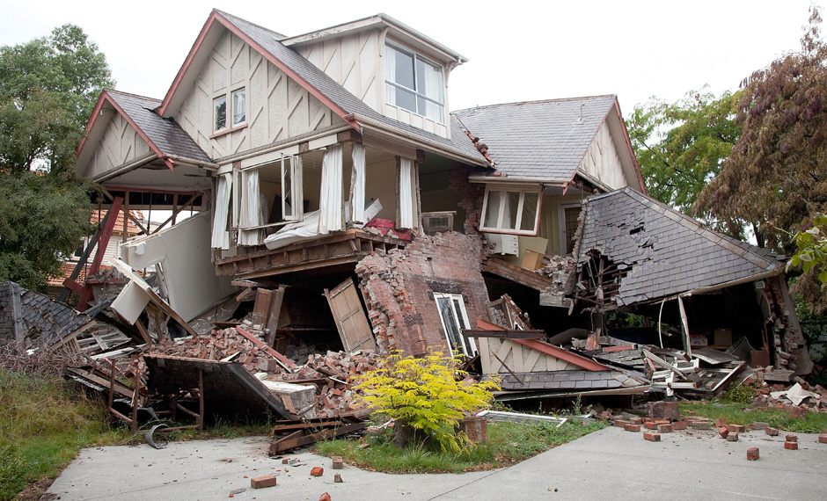
Applications
Sleep Apnea Monitoring
Baby Monitor SIDS Prevention
Search & Rescue
Veterinary Medicine
Fitness Equipment

Slide 7
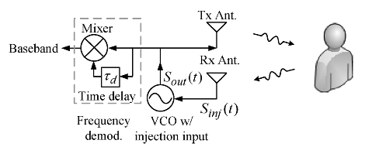

Self-Injection-Locking Vital Sign Radar
F.-K. Wang, C.-J. Li, C.-H. Hsiao, T.-S. Horng, J. Lin, K.-C. Peng, J.-K. Jau, J.-Y. Li, and C.-C. Chen, “A novel vital-sign sensor based on a self-injection-locked oscillator,” IEEE Trans. Microw. Theory Techn., vol. 58, no. 12, pp. 4112–4120, Dec. 2010.
F.-K. Wang, T.-S. Horng, K.-C. Peng, J.-K. Jau, J.-Y. Li, and C.-C. Chen, "Single-Antenna Doppler Radars Using Self and Mutual Injection Locking for Vital Sign Detection With Random Body Movement Cancellation," IEEE Trans. Microw. Theory Techn., vol. 59, pp. 3577-3587, December 2011.

Slide 8
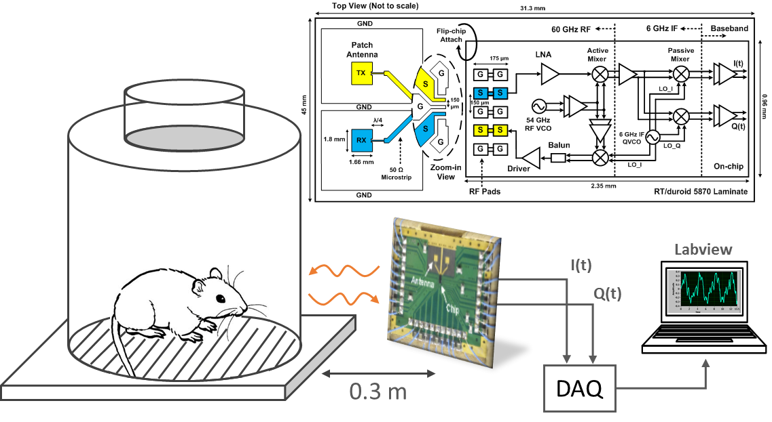
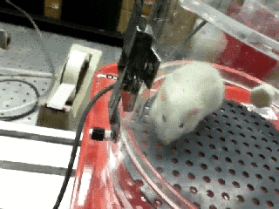

Lab Animal Respiration and Heartbeat
 | Respiration | Heartbeat
Measured Rate | 0.66 Hz | 6.73 Hz
Calculated Displacement | 1.19 mm | 0.13 mm
T. Huang, J. Lin, and L. Hayward, "Non-invasive measurement of laboratory rat’s cardiorespiratory movement using a 60-GHz radar and nonlinear Doppler phase modulation,” IMWS-Bio, September 2015.

Slide 9
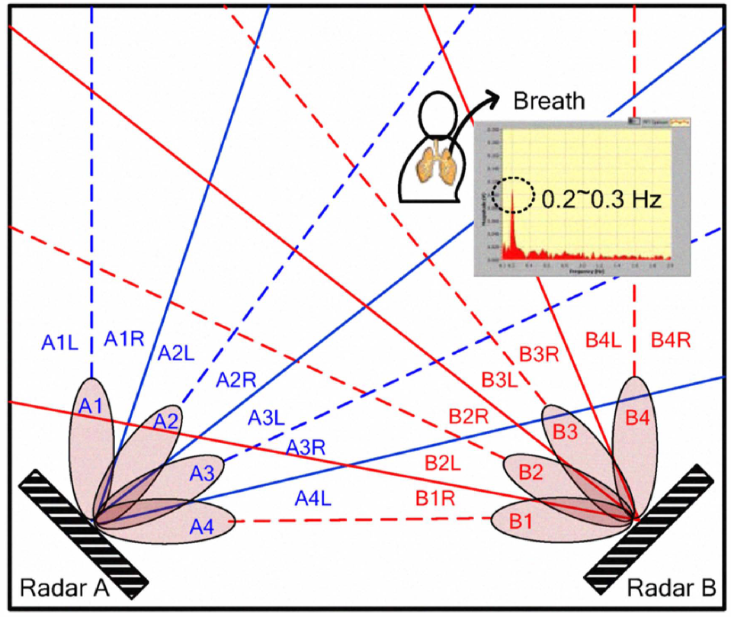

Vital Sign Detection and Positioning
Y.-S. Su; C.-C. Chang; J.-J. Guo; S.-F. Chang, "2-D wireless human subjects positioning system based on respiration detections," Microwave Symposium Digest (MTT), 2012 IEEE MTT-S International , vol., no., pp.1,3, 17-22 June 2012.

Slide 10
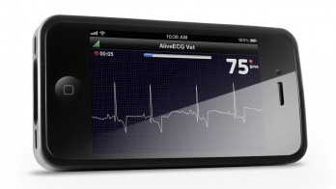
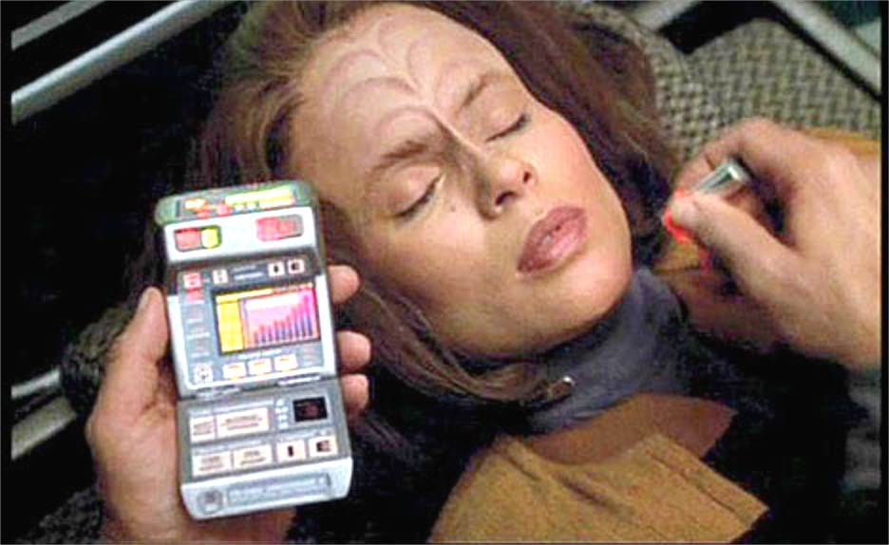
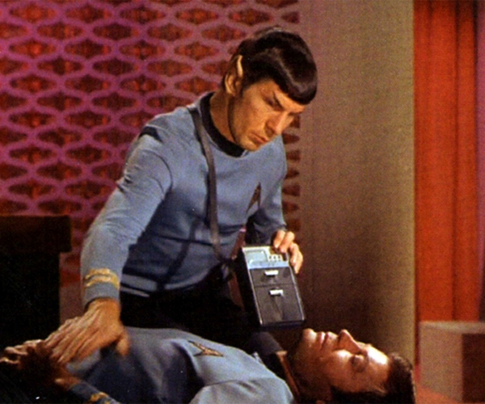
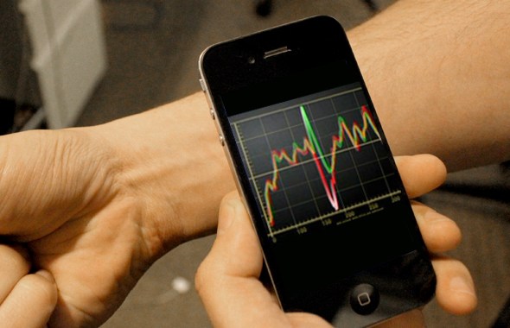
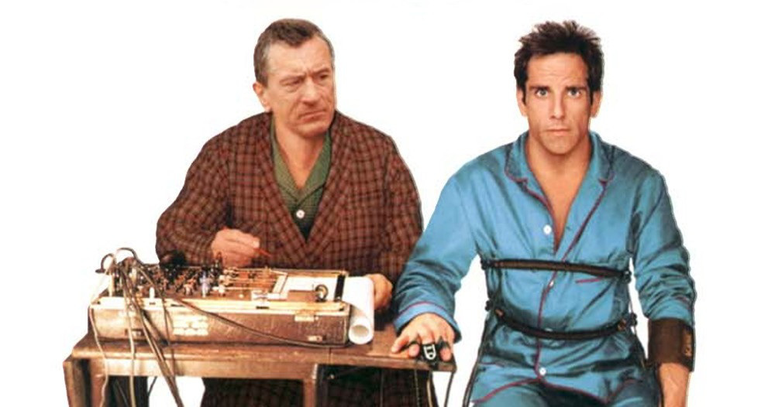
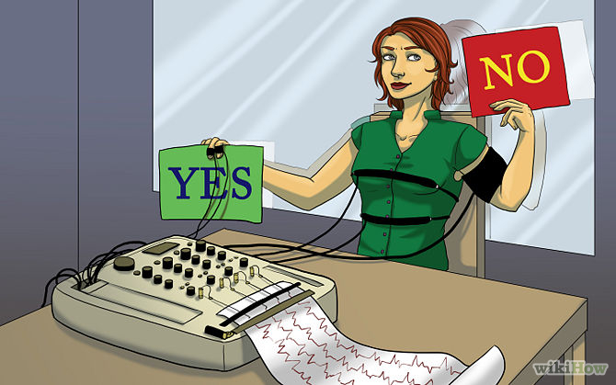
Future Applications
Personal Radar in smartphones
Smartphone Tricorder?
Covert Lie Detection

Slide 11
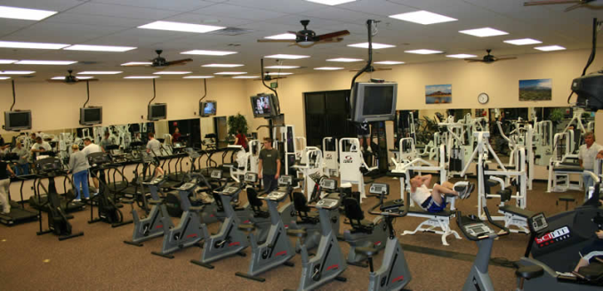
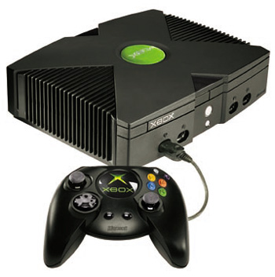
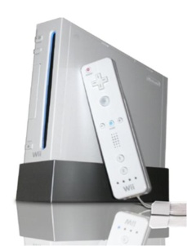

More Future Applications
Emotion Detector – vital sensor in a phone
Sports – fitness center/gym
Vehicle/Transportation
RF Vibrometer
Gaming/Entertainment
quiz contests, video games
virtual reality

Slide 12
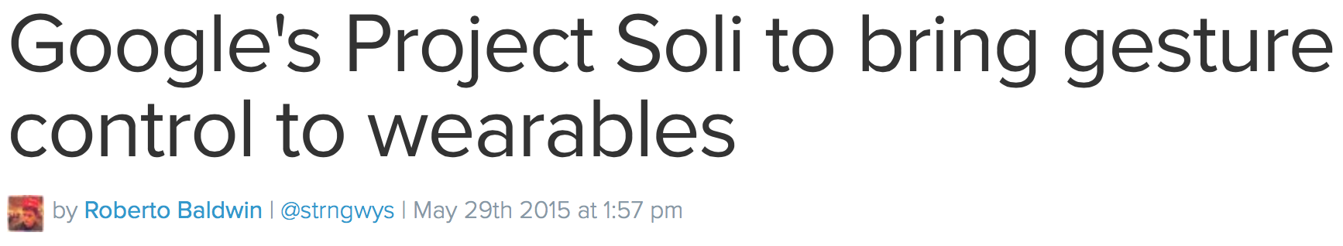
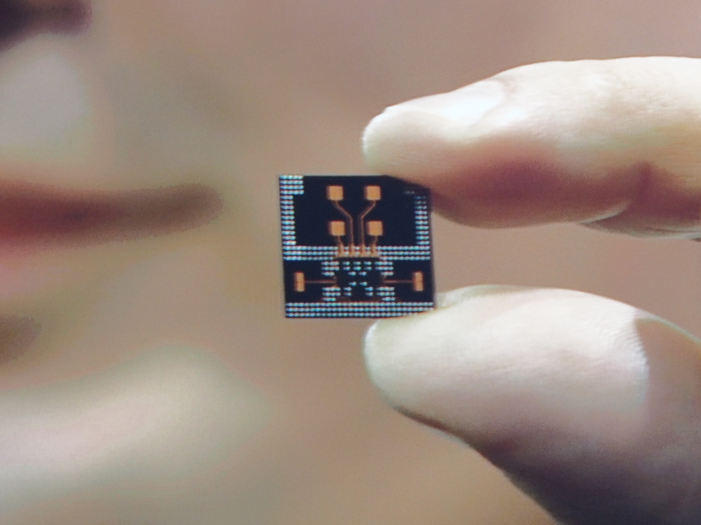
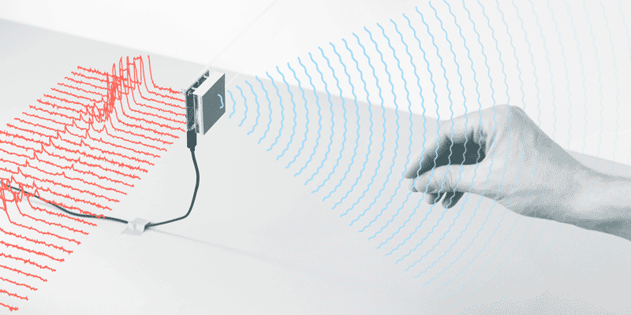
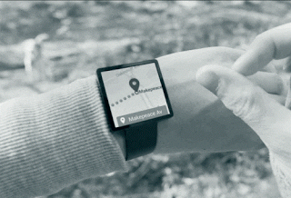
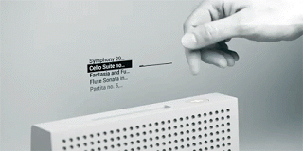
60 GHz frequency
5 mm wavelength
0.05 - 5 meter range
180 degree field of view

Slide 13
2-8 m
2.4 GHz CW radar
Spectrogram: Doppler Frequency vs. Time
walking
crawling
Through-wall measurement
Y. Kim and H. Ling, "Human Activity Classification Based on Micro-Doppler Signatures Using a Support Vector Machine," in IEEE Transactions on Geoscience and Remote Sensing, vol. 47, no. 5, pp. 1328-1337, May 2009.

Slide 14
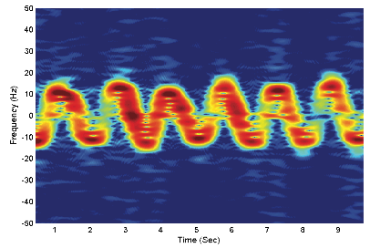
Spectrogram: Doppler Frequency vs. Time
Human Gait Recognition
UWB
Human Marching:
One Arm Swing
Human Marching
Two-Arm Swing
Y. Wang, A. E. Fathy, “Micro-Doppler signatures for intelligent human gait recognition using a UWB impulse radar,” IEEE AP-S Int. Symp. on Antennas and Propagation, July 2011.
RF Biometric
Signature
10 GHz CW
M. Otero, “Application of a continuous wave radar for human gait recognition,” Proc. SPIE 5809, Signal Processing, Sensor Fusion, and Target Recognition XIV, 538 (May 31, 2005).
RFID → Chipless RFID → Tagless RF Identification?

Slide 15
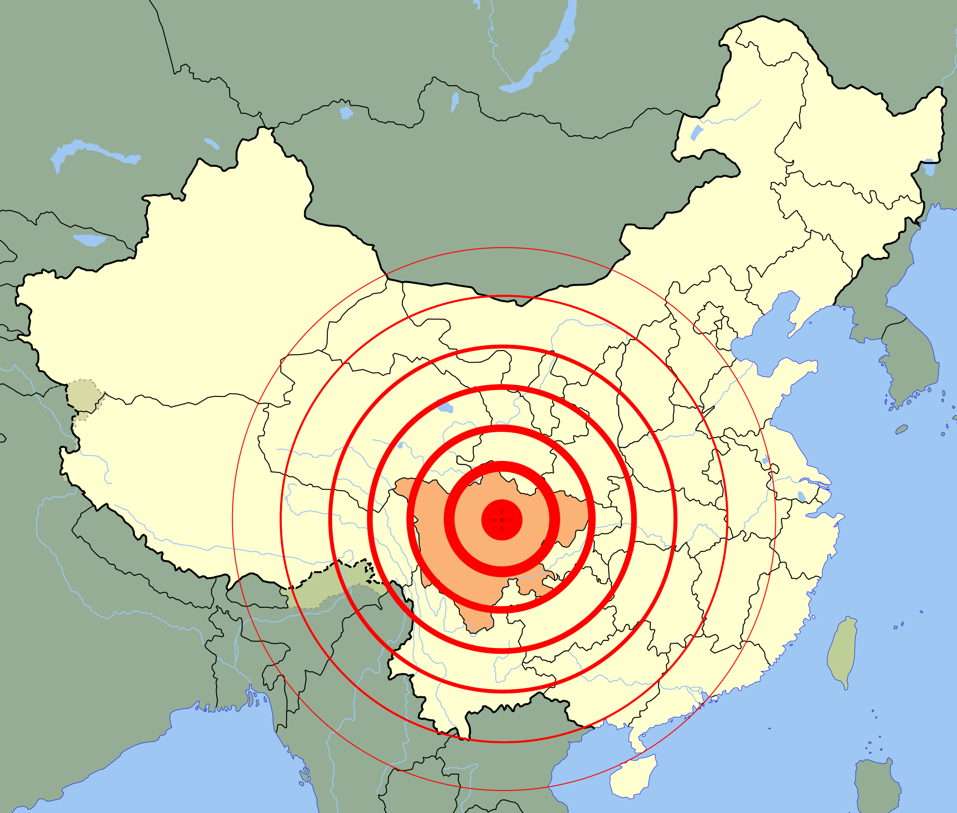
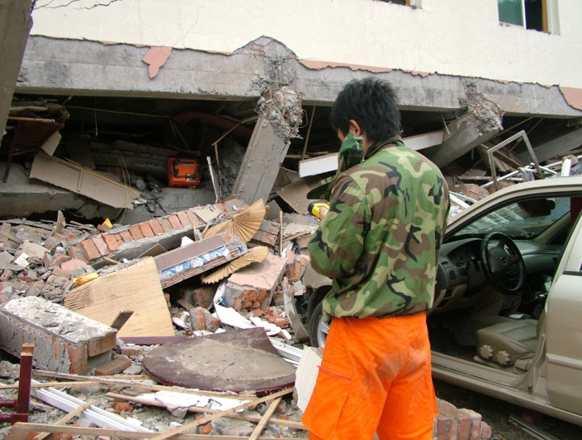
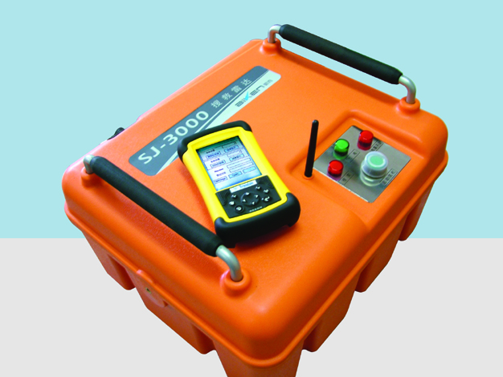
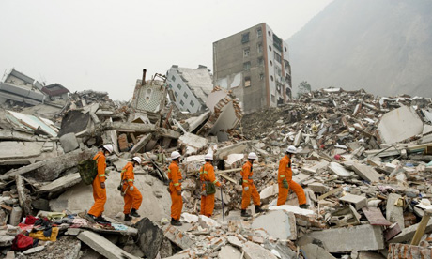
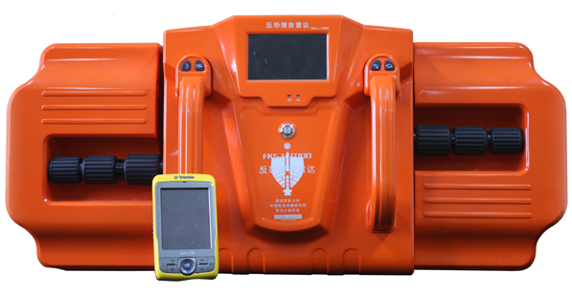
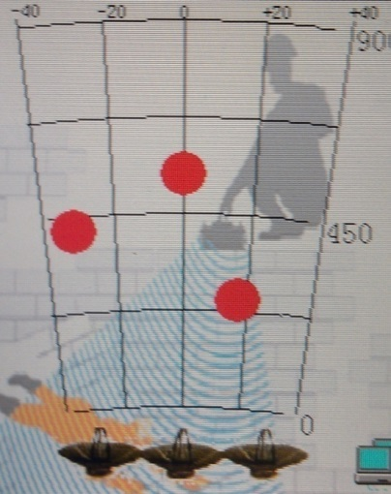
May 12, 2008
UWB radar developed by China’s Fourth Military Medical University and manufactured by Xi’an BIKEN Hi-Tech. Development found and saved more than 10 survivors trapped in ruins.
Sichuan, China
F_{center}: 500 MHz
Range: 15 m
Penetration: 2 m brick wall
Resolution: mm

Slide 16
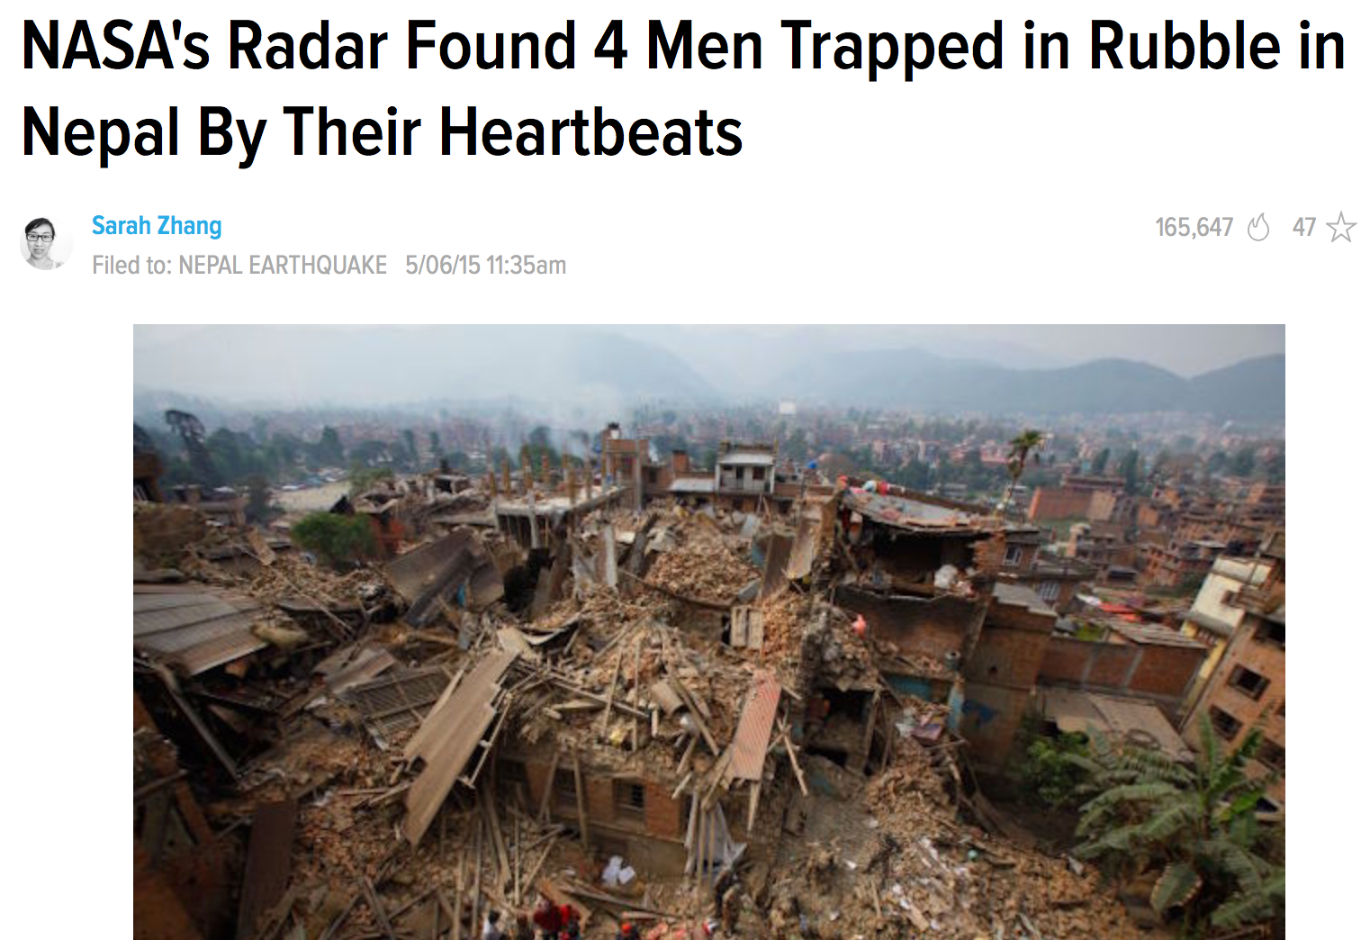
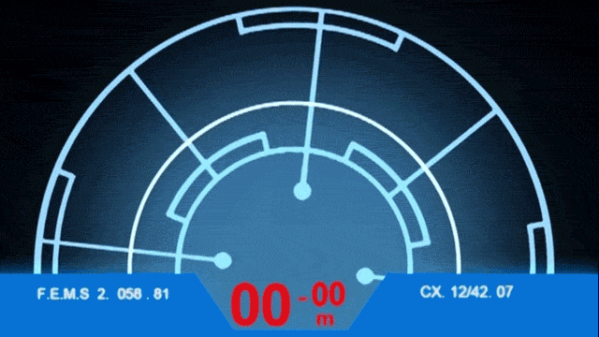
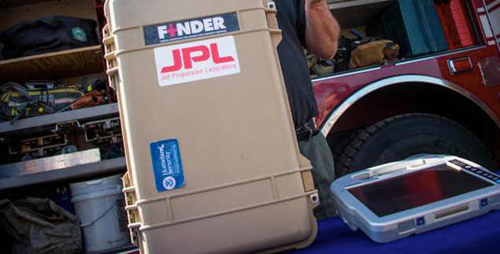


Slide 17
Vital-bot: A vital-sign-searching robot
However, there are fundamental limitations:
EM wave penetration through thick layers of rubbles, especially when wet
Trade-off between penetration depth and resolution/sensitivity
Wireless data link sends detected data to a remote station.

Slide 18
A Solution: Autonomous Small Robots
Fusion of emerging technologies: small radar (IC chip) + wireless power relay + energy harvesting, carried by a small robot
Wireless ad-hoc communications among robots – wireless swarm network
More effective to search survivors deep under rubbles.
A swarm of wireless-powered robotic vital-ants
Wireless power and data relayed from/to a station above ground

Slide 19



What if, a device can sense
amplitudes, phases, and polarizations
of various frequencies in a much
wider spectrum
Electromagnetic (EM) Eye
Applications? Impacts?
Research needed: Electronics, Antennas, Propagation (both near-field and far-field), Signal and Data Processing, …
Electromagnetic Spectrum

Slide 20
Use your imagination

